Slide 1
IOTA Community Logo
IOTA
The distributed communication layer of tomorrow

Slide 2


DISCLAIMER:
NO FINANCIAL ADVICE WILL BE GIVEN IN THIS PRESENTATION
Notes:
Still relevant until Dan gives financial guidelines about the Token

Slide 3
Index
whoami/whoarewe
IOTA Libraries
The IOTA Foundation
Use Cases
What today is about

Slide 4
Index
whoami/whoarewe
IOTA Libraries
The IOTA Foundation
Use Cases
What today is about

Slide 5


whoami/whoarewe
Name Surname
Your Title - yourwebsite.com
Following distributed ledger technology since 2011
Love free and open source software
Project with local company
Notes:
Present the organizers, speakers, supporters
Examples:
Your title, your line of work
what you do
when you started following IOTA

Slide 6
whoami/whoarewe
Name Surname
Your Title - yourwebsite.com
Following distributed ledger technology since 2011
Love free and open source software
Project with local company
Notes:
Present the organizers, speakers, supporters
Examples:
Your title, your line of work
what you do
when you started following IOTA

Slide 7
whoami/whoarewe
Name Surname
Your Title - yourwebsite.com
Following distributed ledger technology since 2011
Love free and open source software
Project with local company
Notes:
Present the organizers, speakers, supporters
Examples:
Your title, your line of work
what you do
when you started following IOTA

Slide 8




Technology
Governance
Ecosystem
Notes:
Important Puzzle Pieces
The Tangle and IOTA technology
The Governance by the IOTA Foundation
The Ecosystem around IOTA

Slide 9

The Tangle
The Tangle is the immutable data structure that contains a history of IOTA transactions.
Notes:
The Tangle is the immutable data structure that contains a history of IOTA transactions. All nodes in an IOTA network store a copy of the Tangle in their ledgers and can read from it and attach new transactions to it.
This removes completely the need to pay fees to miners and thus opens up the possibility to execute microtransactions which could be worth as little as a few cents.
Besides, IOTA’s DAG data structure allows for the network’s easy scalability. Everyone is participating in reaching a consensus and, therefore, the more people are using IOTA, the faster the network becomes.

Slide 10

The Tangle
The unique data structure being utilized in IOTA
Directed Acyclic Graph (DAG)
Scalable distributed framework for transactions
Transactions can hold data, value or both
Consensus
Notes:
DAG - The references among transactions form a type of directed acyclic graph (DAG), which is a sequence of vertices where every edge is directed from an earlier point to a later one in the sequence (the animation shows the three dimensional version)
Scalability - When a node attaches a new transaction to the Tangle, that transaction directly references two existing ones (make a simple multiplication to show how numbers grow)
Consensus - Network nodes are responsible for validating transactions and their histories to make sure that they don't conflict.
When a node has a transaction's entire history, the transaction is considered solid, which means that it can be considered for confirmation.
Resources for the speaker:
https://docs.iota.org/docs/dev-essentials/0.1/concepts/the-tangle

Slide 11

IOTA nodes
IOTA networks consist of interconnected nodes that run the same node software
All participants are equal
Read/write access to the Tangle
Validate transactions
Store transactions in their local ledgers
Notes:
Nodes are the backbone of an IOTA network as they are the only devices that have read and write access to the immutable record of transactions called the Tangle.
Interconnected nodes form an IOTA network by running the same node software, allowing them to validate transactions and attach them to the Tangle.
Miners versus users: IOTA has no miners, and therefore no incentives to slow the network down to raise fees, and other conflicts of interest.
There are no miners, and therefore no miner fees. Each transaction sends the full input amount.
Each node in an IOTA network validates transactions, then sends them to other nodes that do the same. As a result, all valid transactions are agreed on by all nodes, removing the need to trust a single one in the network.
Creators of transactions must verify two previous transactions within the network and each transaction requires a small PoW computation on behalf of the user. Notably, there are no fees when utilizing a Tangle as the network is not heterogeneous where incentives need be applied to distinct participants in the ecosystem.

Slide 12

IRI
IOTA reference implementation
Open-source Java software
Nodes in the public IOTA networks
Clients can transfer IOTA transactions among each other
Validate transactions
Notes:
By running your own IRI node you have the following benefits:
You have direct access to an IOTA network instead of having to connect to someone else's IRI node
You help the IOTA network to become more distributed by adding to the number of ledgers and validating the transactions in your neighbor's ledgers
Limitations
The IRI receives transactions and records them in its ledger, it doesn't create or sign transactions. To create or sign transactions, you must use client software such as Trinity or a client library and send the transactions to an IRI node.
Speaker reference
https://docs.iota.org/docs/node-software/0.1/iri/introduction/overview

Slide 13
IRI - Benefits
Direct access to an IOTA network instead of having to connect to someone else's IRI node
Support the IOTA network to become more distributed by adding to the number of ledgers and validating the transactions in your neighbor's ledgers
Notes:
Limitations
The IRI receives transactions and records them in its ledger, it doesn't create or sign transactions. To create or sign transactions, you must use client software such as Trinity or a client library and send the transactions to an IRI node.
Speaker reference
https://docs.iota.org/docs/node-software/0.1/iri/introduction/overview

Slide 14

Chronicle
Permanode solution
Store all transactions that reach an IRI node
Distributed database that's secure and that scales
Notes:
What is a permanode?
A permanode stores the full history of the Tangle and enables applications to search the data through an extended API.
Why run Chronicle?
IOTA is a permissionless network. Anyone can store any amount of data on the Tangle for free (just a small amount of proof of work per transaction).
Over time, the ledger of an IRI node accumulates many transactions, which often cause it to become larger than the node's available memory. To stop the ledger from becoming too large, these nodes often do local snapshots that prune old transactions.
Speaker reference
https://docs.iota.org/docs/node-software/0.1/chronicle/introduction/overview

Slide 15
Chronicle - Benefits
Financial data must be stored for 10 years in some cases, and identity data needs to be kept for the lifetime of the identity
Store all the IOTA transactions in a secure, scalable, and distributed database
Monetization of the permanode
Notes:
For many business use cases, data in the IOTA Tangle needs to be stored for longer periods of time. For example, financial data must be stored for 10 years in some cases, and identity data needs to be kept for the lifetime of the identity.
Chronicle makes it easy for node owners to store all the IOTA transactions in a secure, scalable, and distributed Scylla database.
Speaker reference
https://docs.iota.org/docs/node-software/0.1/chronicle/introduction/overview

Slide 16
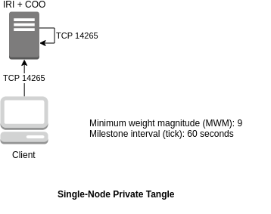
Private Tangle
An IOTA network you control
Explore the technology
Set up a faster IOTA network
Develop and test an application
Showcase the technology
Notes:
A private Tangle is an IOTA network that you control and that contains only nodes that you know. A private Tangle uses the same technology as the public IOTA networks, except you control it by running an open-source implementation of the Coordinator called Compass. You can use Compass to allow nodes to reach a consensus on transactions attached to your private Tangle. If Compass stops, no transactions in your IOTA network will be confirmed until it starts again.
Explore the technology: If you have little or no experience with IOTA, you can set up your own private Tangle to help you understand the technology and how you can benefit from it.
Set up a faster IOTA network: If your use cases need a faster network speed than the public IOTA networks can currently provide, you can set up your own private Tangle to increase the number of transactions per second. For example, you could lower the value of the minimum weight magnitude to make proof of work quicker.
Develop and test an application: If you want to develop or test an application on IOTA, you may want to do so on a private Tangle so that your transactions aren't visible to the public. Having a private Tangle also has the added benefit of being able to reset the network to start all tests from the same point.
Showcase the technology: If you want to show your ideas to others, you may want to set up a private Tangle so you can make sure that everything runs smoothly during your presentation.
Speaker reference
https://docs.iota.org/docs/compass/0.1/introduction/overview

Slide 17
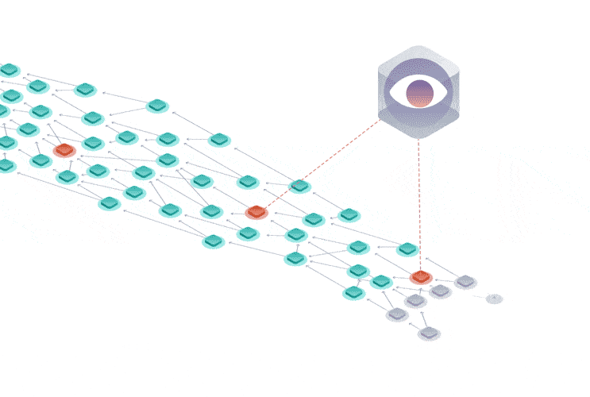
The Coordinator - Compass
The Coordinator
Milestones
Notes:
The Coordinator is an application that creates, signs, and sends bundles of transactions from the same address at regular intervals. Each of these bundles contains transactions called milestones that nodes use to reach a consensus. When milestones directly or indirectly reference a transaction in the Tangle, nodes mark the state of that transaction and its entire history as confirmed.
The Coordinator sends milestones to nodes at regular intervals, and nodes use these milestones to reach a consensus.
When nodes see a transaction that's been sent from the Coordinator's address, they validate it by doing the following:
Make sure that it doesn't lead to a double-spend
Verify its signature
Because IOTA uses the Winternitz one-time signature scheme (W-OTS), addresses must not be withdrawn from more than once. To allow the Coordinator to sign multiple bundles whose signatures can still be verified against one address, that address is derived from the Coordinator's Merkle tree.

Slide 18
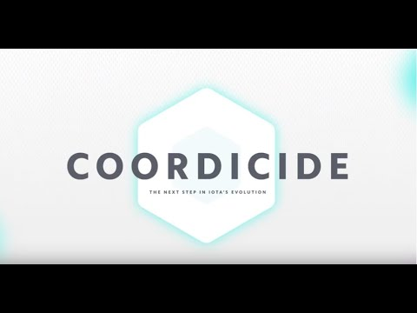
The Coordicide
https://youtu.be/guNNqEeu6gY

Slide 19
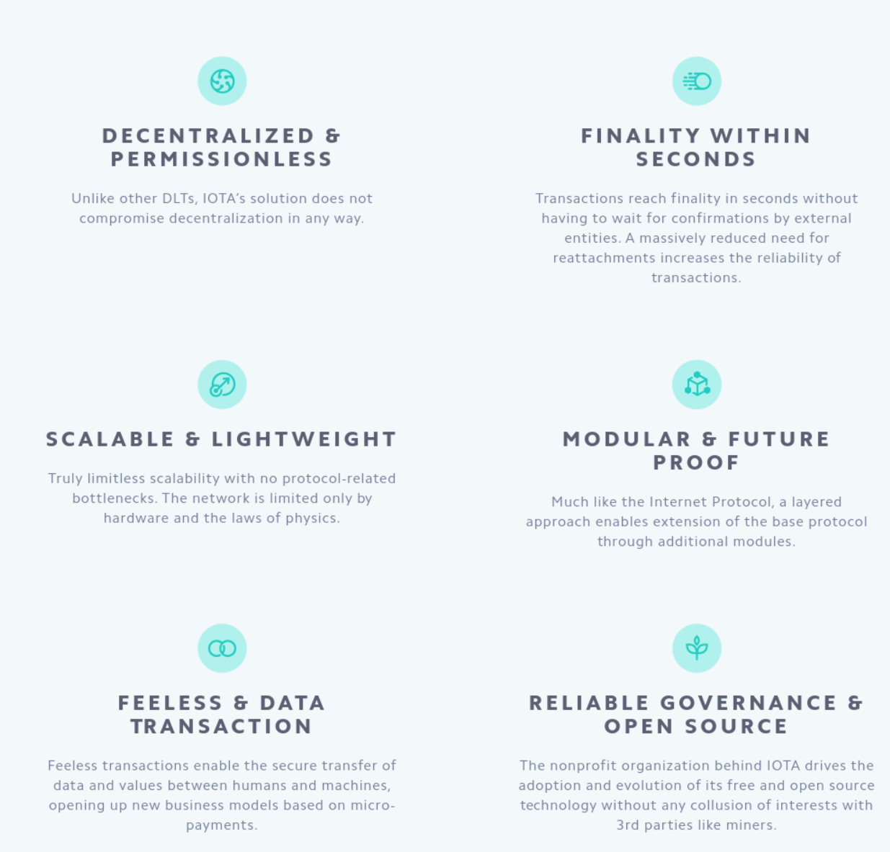
The Coordicide
Node Identities
Auto-peering
Spam Protection
Tip Selection
Shimmer
Notes:
NODE IDENTITIES
Build a reputation and help secure the network by being a good actor.
AUTO-PEERING
Connect to the network automatically, simplifying node setup and maintenance.
SPAM PROTECTION
Enables low-powered IoT devices to access the network through an adaptive rate control mechanism.
TIP SELECTION
An optimized tip selection algorithm improves confirmation times and ensures transaction confirmation.
SHIMMER
The revolutionary voting module reaches a consensus in seconds. By leveraging proactive communication in the network it enables near-instant irreversible transactions.

Slide 20

GoShimmer
Prototype software with Coordicide modules
Auto-peering
Node identities
Notes:
GoShimmer is a work-in-progress prototype of a node software that allows nodes to reach a consensus without the Coordinator, allowing IOTA networks to be decentralized.
Auto-peering: Each new node on the network tries to connect to four neighbors and accepts connections from a further four neighbors
Node identities: Each node creates a unique public/private key pair. The public key is used to identify nodes during auto-peering. In the future, these identities will allow nodes to receive mana.
When all the modules become available, the GoShimmer nodes will become the Coordicide testnet, which is a release candidate for the next IOTA protocol.
Speaker reference
https://docs.iota.org/docs/node-software/0.1/goshimmer/introduction/overview

Slide 21
GoShimmer - Benefits
By running a GoShimmer node, you can test the cutting-edge developments in the next stage of the IOTA protocol
Notes:
GoShimmer nodes run the prototype software that includes the following Coordicide modules:
Auto-peering: Each new node on the network tries to connect to four neighbors and accepts connections from a further four neighbors
Node identities: Each node creates a unique public/private key pair. The public key is used to identify nodes during auto-peering. In the future, these identities will allow nodes to receive mana.
When all the modules become available, the GoShimmer nodes will become the Coordicide testnet, which is a release candidate for the next IOTA protocol.

Slide 22

HORNET
Community driven node
GoShimmer as the base
Compiled to native code
Increased performance
Easy to install
Lightweight alternative to IRI
Runs on low-end devices
Notes:
Ecosystem Development Fund project
Developers:
Maximilian Hase (muXxer#1289)
Alexander Sporn (alexsporn#6593)
Sebastian Fuchs (IoTMOD#0279)
Luca Moser — IOTA Foundation (Luca Moser [IF]#4960)
Low-end devices (Raspberry PI 3)
Speaker reference
https://blog.iota.org/introducing-hornet-a-lightweight-iota-node-2b3b750348f5
https://blog.iota.org/the-5th-cohort-of-iota-ecosystem-development-fund-grantees-5cbf05227525
https://medium.com/@gohornet/milestone-1-the-hornet-awakens-7199cb6c69e7

Slide 23
HORNET- Benefits
The modularity makes it possible to use modules from GoShimmer within HORNET without many modifications to the code
HORNET is supposed to become a node software, which is created by the community for the community

Slide 24

The IOTA Foundation
The IOTA Foundation - to research, develop and grow market adoption of DLT
Non-profit Foundation based and regulated in Berlin, Germany
Growth from 6 to 100+ full time employees distributed across 27 countries
Focused on technical and regulatory challenges of crypto-currencies & DLT
Notes:
Make sure to emphasize that IF's goal is to be irrelevant in 5 years. One of many actors guiding, building, using the Tangle

Slide 25

IOTA Foundation - Vision & Goals

Slide 26

IOTA Ecosystem
Our universe relies on a network of many collaborators
– corporates, academics, governments, NGOs
Notes:
Sources for official Ecosystem
https://blog.iota.org
https://ecosystem.iota.org
Sources for unofficial Ecosystem:
https://iota-archive.com/

Slide 27

IOTA Ecosystem
Meet the IOTA Ecosystem
Tutorials
Projects
Events
Developers
Notes:
The IOTA Ecosystem is a hub of education, innovation, tools, collaboration and development for the IOTA distributed ledger protocol and is lead by the IOTA Foundation.
The Ecosystem also is responsible for the Ecosystem Development Fund.
Resources for speaker:
https://ecosystem.iota.org

Slide 28

IOTA Ecosystem Development Fund
Funding for projects in the IOTA Ecosystem
Proof of concepts
Open source utilities and libraries
Educational resources
Media
Philanthropic endeavors
Hackathons
Ideation workshops
Meetups
Notes:
Ecosystem Development Fund Is a collection of donations that are granted to IOTA related projects
Is committed to Transparency, accountability and by memorializing EDF funding agreements with ‘Proof-of-Existence’ transactions on the Tangle, anyone will be able to verify that agreements the EDF enters existed in a certain state at a certain point in time. The IOTA community can thus hold both the EDF and the benefactors of EDF
Resources for speaker:
https://fund.iota.org

Slide 29

Coordicide Grant Program
Research Grant
Optimization of the networking layer to avoid network congestion
Reputation system based on node behavior
Theoretical behavior of cellular automata based consensus
Theoretical properties of query-based voting schemes (e.g., FPC)
https://coordicide.iota.org/grants
Notes:
This project is IOTA’s top priority, and there is the possibility to collaborate through the Coordicide grant program, which offers both large and small grants for research on any aspect of Coordicide.

Slide 30
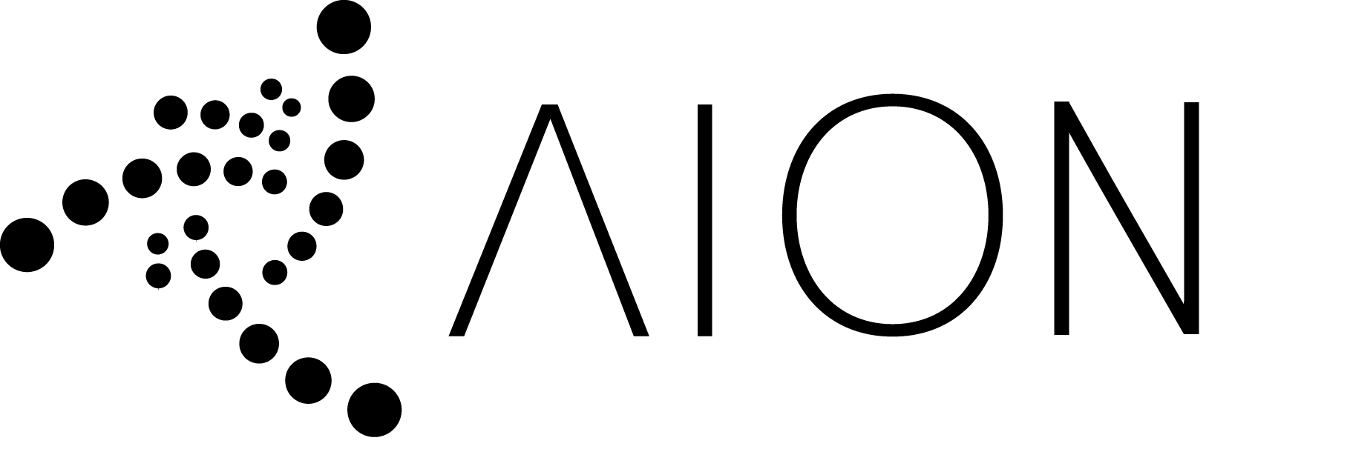
AION - Selective Permanode
Selective permanode solution
Keeps a pruned Tangle mathematically intact
Developers can host their own data
Data becomes transferrable
Ecosystem developer fund grantee
Notes:
Developers can host their own data
Right now if you are developing with IOTA and don’t want your Proof of Concept have it’s data removed all the time from an immutable ledger then you are stuck with hosting the entire tangle and disable snapshotting.
With AION you will be able to do snapshotting and keep the data that is only relevant to your application. Important to mention is that this works in constant time. Meaning that the variations in Transactions Per Second will NOT influence your personal storage requirements.
Data becomes transferrable
The unique way AION describes what needs to be stored also introduces a way to efficiently communicate what data you want from other nodes. Allowing you to push a certain subset of the Tangle from one node to another. Creating the ability to do data replication for important data, like Digital Identity. Or just for the sake of back-ups.
Resources for speaker:
https://medium.com/coinmonks/aion-33e01538dadf
https://www.youtube.com/watch?v=giatJB-j2pE&t=1962s

Slide 31
Hornet - IOTA Fullnode
Entirely written in Go
IOTA fullnode on low-end devices such as a Raspberry Pi
Ecosystem developer fund grantee
Notes:
Resources for the speaker:
https://blog.iota.org/the-5th-cohort-of-iota-ecosystem-development-fund-grantees-5cbf05227525
https://medium.com/@gohornet/milestone-1-the-hornet-awakens-7199cb6c69e7

Slide 32
Contacts:
Sponsors:
Get involved:
email@provider.com
website.com
twitter.com/myhandle
linkedin.com/in/mylink
<SPONSOR NAME>
<Description>
sponsor.website.com
Website:
Ecosystem:
Discord:
Twitter:
LinkedIn:
YouTube:
www.iota.org
ecosystem.iota.org
discord.iota.org
twitter.com/iotatoken
linkedin.com/company/iotafoundation
www.youtube.com/c/iotafoundation

